Slide 1
[Agency Name]
[Proposed Project Name]
[Insert Agency Logo]
Fiscal Year 2028 C2 Business Case Presentation
Priority: [1, 2, 3…etc.]
Presentation Date: [mm, dd, yyyy]
Cabinet Secretary or Agency Director: [name]
Chief Information Officer: [name]
Project Manager: [name]

Slide 2
I. Executive Summary
[Begin with a brief but concise description of the proposed project.
Include the following:
A brief description of the business problem– “why” the solution is being requested;
The value and benefits to the agency;
Key objectives the project aims to address;
How the project aligns with the agency strategic plan.
Note: the Executive Summary should not be more than one slide.]

Slide 3
II. Project Background
Project Description:
[Provide a detailed project description.
Is this project a new solution, are you upgrading or enhancing an existing solution, replacing an existing solution or are you requesting funds for analysis and planning?
Include the technology type (commercial off the shelf, software as a service, a custom developed solution, electronic content management or other type) and any professional services, hardware/infrastructure, software, training, compliance and security, facilities, personal services or other items required.
Is the system being considered a hosted solution?
What is the estimated start and end date of the project?
If full funding is not available, can the project be phased?
What can be accomplished with partial funding.]

Slide 4
II. Project Background
Project Background:
[Is this a new request, a continuation that has been funded in previous years, part of a phased implementation or a repeat request for funding that has been denied?
If previously funded, include the fiscal year(s), appropriation amount(s) and any reauthorization(s) if applicable; and
Describe the project’s key milestones to date.]

Slide 5
III. Risk Assessment for Proposed Solution
Criteria |  | Risk Score = 1 | Risk Score = 2 | Risk Score = 3 | Score
1 | Estimated project cost | Less than $250K | $250K - $1M | Greater than $1M
2 | Estimated total calendar months before completion | 6 or less | 6 to 12 | More than 12
3 | Number of project team members | 5 or less | 6 to 10 | More than 10
4 | Number of subject matter experts required to execute the project | 3 or less | 4 or 5 | 6 or more
5 | Project manager experience level | 3 or more projects of similar scope | 1 to 2 projects of similar scope | No prior projects of similar scope
6 | Estimated total effort hours | Less than 500 | 500 - 1800 | More than 1800
7 | Number of sites/offices impacted by the project | 1 | 2 to 5 | More than 5
8 | Uniqueness of project's technical requirements | Similar to others in the department | Similar to others, but complex | New and complex
9 | Impact of noncompliance with applicable laws and regulations | None or minimal | Moderate | Significant
10 | Impact of 12-month project postponement on existing systems | Existing systems can compensate with minimal costs | Existing or new systems can compensate with substantial costs | Existing systems must be curtailed because of the lack of proposed project
11 | Number of interfaces to existing systems affected | 0 | 1 to 3 | More than 3
12 | User requirements definition | Clearly defined | Somewhat defined, but complex | Very vague and complex
 |  |  |  | Total Risk Score:

Slide 6
V. Alternative Analysis
Justification For Project Selection: [Please use the narrative in your business case to explain why you chose this project over the alternatives. Include research and analysis conducted.]

Slide 7
VII. Objectives, Outcomes, Key Performance Indicators
Objectives | Outcomes/Deliverables | KPIs (if applicable)

Slide 8
VII. Benefits
Tangible Benefits | Metrics
Intangible Benefits

Slide 9
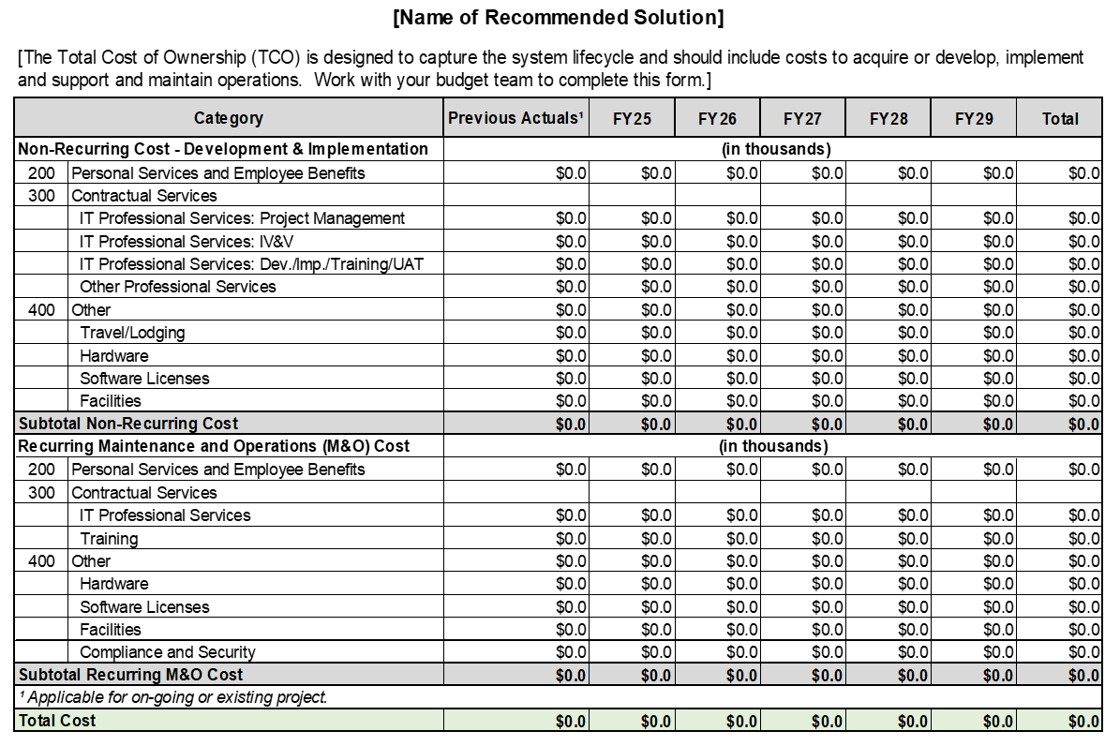
IX. Total Cost of Ownership [Copy table from Full Business Case]

Slide 10
X. C2 Funding Request
  [Begin with the total amount agency is requesting for this project.
  List the individual amounts from each category, whether it be, general fund, other state funds (specifying name of fund), federal funds, internal svc funds/interagency transfer.
  State what you plan to accomplish with the funds:
  Complete entire project
  Complete initiation and planning
  Complete implementation of Phase X]

