Slide 1
INTERNET FOR ALL: REGIONAL & STATEWIDE BROADBAND INITIATIVES & LOCAL FUNDING OPPORTUNITIES AHEAD CIO Forum September 27, 2022

Slide 2
GOAls for Today
Meet and Greet
State and OBAE Update and Opportunities
What is Next and Action Steps

Slide 3
Acronyms
NTIA- National Telecommunications and Information Administration
BEAD – Broadband Access Equity and Deployment
ARPA – American Rescue Plan Act of 2021
TCP - Tribal broadband Connect Program
CNMC - Connect New Mexico Council
USDA - US Dept of Agriculture
FTTH/FTTP – Fiber to the Home/Fiber to the Premise
OBAE - Office of Broadband Access and Expansion
PEN - Public Education Network

Slide 4
STATE UPDATE
Legislation: HB10 and SB93 and SB 377
Office of Broadband Access and Expansion (OBAE)
Connect New Mexico Council (CNMC)

Slide 5
Building OBAE Team and STRATEGY: EIGHT week Accomplishments
Funding: met key milestones for submitting plans for federal funding:
Digital Equity July 18, BEAD August 15 and Middle Mile September 30; ARPA Sept 24
Announced Notice of funding grant program Aug 8 and set 3 app windows. 4 webinars and application portal; added alternative technologies
Staffing well underway:
Hired 4 people: Exec Assistant (on board), GIS (starts Oct 3), Ops Manager (on board), offer to Deputy Director
Developed 6 contracts, SOWs, and Work Orders for 6 consultants to get help
Hired Finlay as engineering consult firm and CTC as Program mgmt consult firm
Compliance mgr and grants mgr interviews in process
Digital Equity and data collection report to LFC Oct 1 per HB 10 on track and detailed Broadband plan Jan 1 based on consortium plan
Community Engagement:
Held Tribal Convening Summit Sept 12 starting a series of quarterly tribal summits
Traveled for 5 site visits to understand needs and fold into broadband plan
Coordinating with FCC for accurate maps
Map Challenge Summit Sept 23
Engaging RLS2 for more accurate and speedy map updates

Slide 6
EIGHT wEEK OBAE Accomplishments (cont.)
Developed Middle Mile and Last Mile Strategy based on 5 pillars
Coordinated with Public School Facility Agency (PSFA) and OBAE for Statewide Education Network (SEN) as foundation for Middle Mile –Joint Powers Agreement
Two RFIs to ISPs and tribes to coordinate letters of support
Visited candidate nodes, meet me aggregation points at higher ed locations. Got agreement for new node locations
Submitted GEER II application to fund the node facilities to have the right electricity, cooling and generators
Drafting legislation to remove obstacles:
Anti-donation
ROWs
P3’s
Clean-up of HB10 and SB93
Developed key relationships
CNMC for rulemaking and defining roles of CNMC, DOIT and OBAE. Participate in 6 Working grps
Started workforce development program planning
Developed plan for 4 rural clinics to get connectivity for telehealth appointments
Briefed several LFC subcommittees (STTC 2x, TIRS, Rural subcommittee on progress and plan

Slide 7
The Five OBAE Pillars
Foster Collaboration and Partnerships:
(e.g., SEN, PEN, RFN, Connect NM Council, Tribes and Pueblos, P3s, ISPs, Telcos, Coops, Counties, Border states, Nonprofits,state agencies, Coalitions, Consortiums, Collectives, etc.)
Support a Robust Fiber State-wide Middle Mile
Plan the Foundation for
Broadband (BB) Connectivity within 5-Year Period
Create and Adopt Innovative Approaches (e.g., Spectrum, best practices, lessons learned, best in class tools)
Nurture Alternative Technologies (e.g., MM Wireless, HAPS, Satellite, Photoelectronics, Mesh Networks, etc.)

Slide 8
100% Connectivity: >$1B Funding Enables BB Buildout
NTIA Digital Equity Funds
Submitted plan July 12. Releases $740K Planning Funds
NTIA BEAD
Funds
Submitted GOV Letter of Intent (LOI) July 18.
Implement Last Mile 2024+
NTIA MM Funds
Architecting State-Coordinated Statewide MM Plan. ISP or ISP coalitions may submit independently.
Submit detailed plan October 01 2023. Releases DE implementation funds
Engaged SME contractors for community + tribal outreach and Digital Equity (DE) Planning
Implement DE Plan October 2023 - 2025
Submitted plan August 15. Releases $5M planning funds
Submit detailed plan May 2023. Releases broadband infrastructure funds
Award grants when funding released
Outreach and detailed planning September 2022 - September 2023
On track for September 30 submittal. Releases middle mile infrastructure funds.
Implement Middle Mile 2023+
Award Grants when funding released
$30M+*
$$700M+*
$$50M -100M*
*estimates
8

Slide 9
100% Connectivity: >$1B Funding Enables BB Buildout (continued)
Connect NM Council
Council members appointed, Interim Chair Selected and Established Six Working Groups
ARPA
Developed Pilot Grant Program, application and scoring criteria
Tribal Connect Fund
Announcement of Round 1 August 11 $146M – 5 applications won
Allocated $70M by Legislature for MM and Last Mile deployment
USDA Funds
Round 2 - riolling
Six NM Awardees announced for loans and grants
Implementation 2022+
Implementation 2022+
Rulemaking in process
Award Grants 2023+
On track for Week of August 8 Notice of Funding Opportunity (NOFO)
Award Round 1 of grants starting Fall 2022
Implement Middle Mile/Last Mile 2022+
$$70M
$$123M
$$200M*
$$57M
* estimate

Slide 10
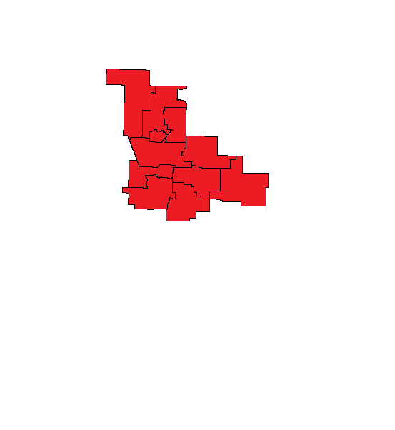
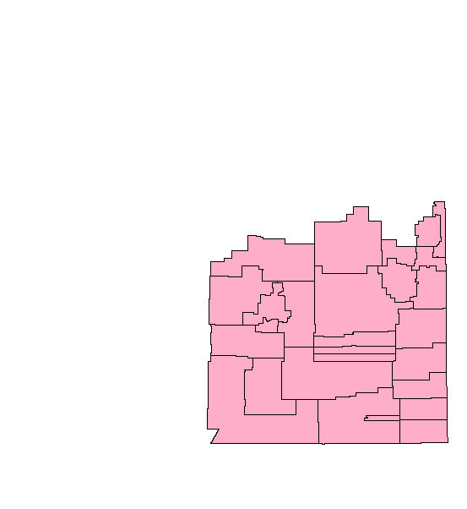
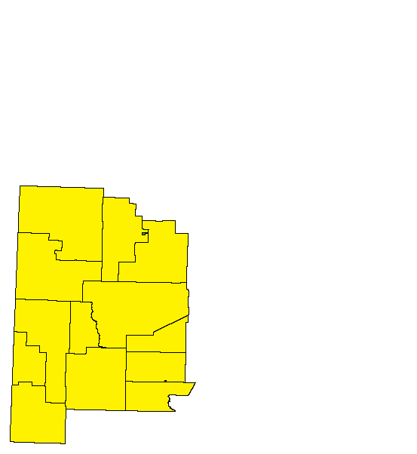
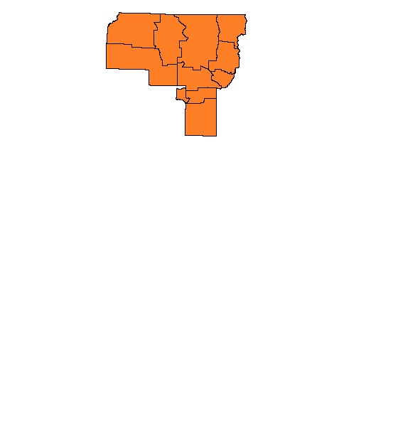
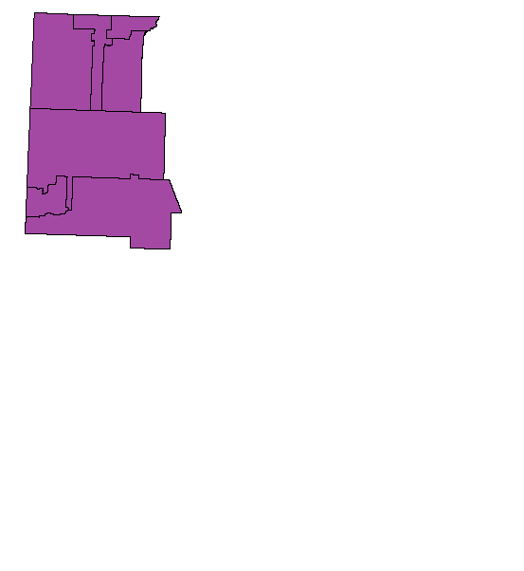
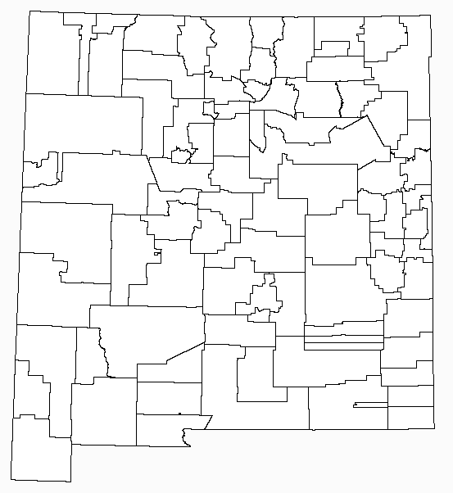
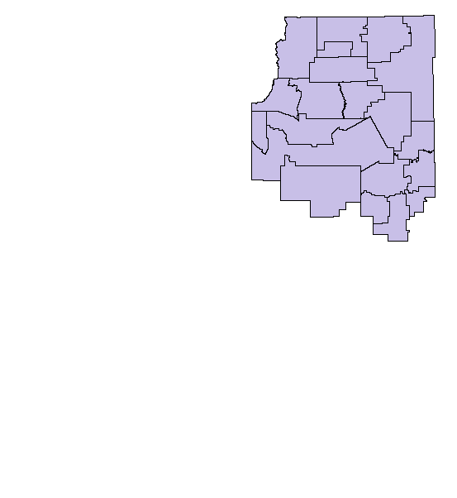
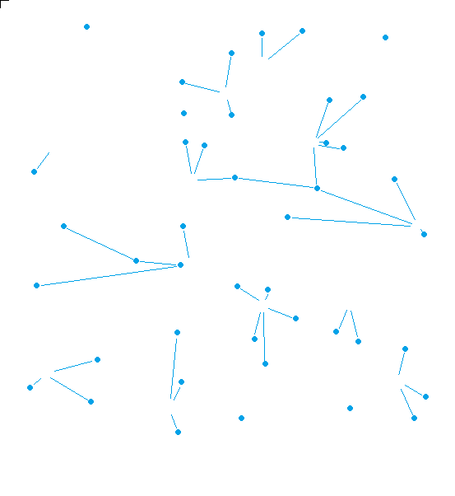
SEN is foundation for the State Middle Mile
Nodes
Major Routes/Internet
“Meet me” aggregation points
Upgrading electrical and cooling systems for HigherEd facilities housing SEN Nodes
Adding key corridors, closing of rings for resiliency and a box around the SEN
Becomes launching points for last mile

Slide 11
Strategy
Implement SEN to establish regional aggregation sites (Nodes) operations with E-rate funding (for sustainability)
Use Nodes as landing sites for existing and new Middle Mile (supporting ISP and state coordinated NTIA applications)
Maximize NTIA funding for Last Mile with all the tools at state's disposal (mapping etc...)
Coordinate Last Mile deployment while removing all obstacles (permits, ROW & pole attachments)
Develop and implement a robust digital equity statewide program
Deployment projects are already starting:
Upgrades in Gallup and surrounding areas (Gallup node, Crownpoint, South of Gallup, Zuni pueblo)
Deployments to rural residents in Fort Wingate (fiber to the home and mesh wireless) t
Direct technical support for municipality driven projects and partnerships with industry like in Jal New Mexico.
Celebrate victories along the way

Slide 12
Lessons
Broadband Needs to plan in cyber security
Broadband work is not same as Information Technology (IT) but related
Broadband is complex and will require manpower to properly implement (adequate for a $1-3B program over 5 years)
Strategy and plan must be developed with input from rural NM, local ISPs, tribes, and agency CIOS

Slide 13
Help Needed
Need your support and participation in Broadband deployment
Example: DOH and HSD need your help to get rural clinics to get connected
Example: PED, HED, early childhood education (meeting every 2 weeks to coordinate how to connect childhood centers, students and teachers in Gallup)
Need your help for identifying opportunities in your departments, agencies and branch offices
Needs assessment – template and survey coming in a few months
Be thinking of your agency/dept needs

Slide 14
Questions?

Slide 15
backup

Slide 16
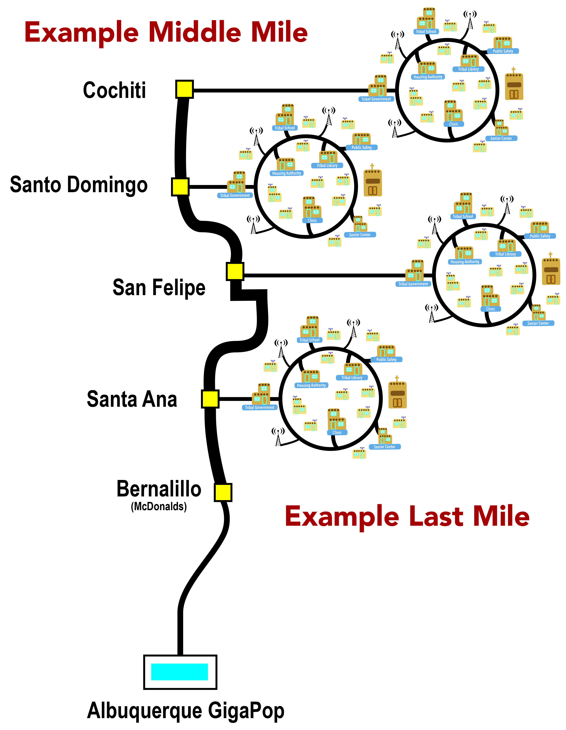

Slide 17
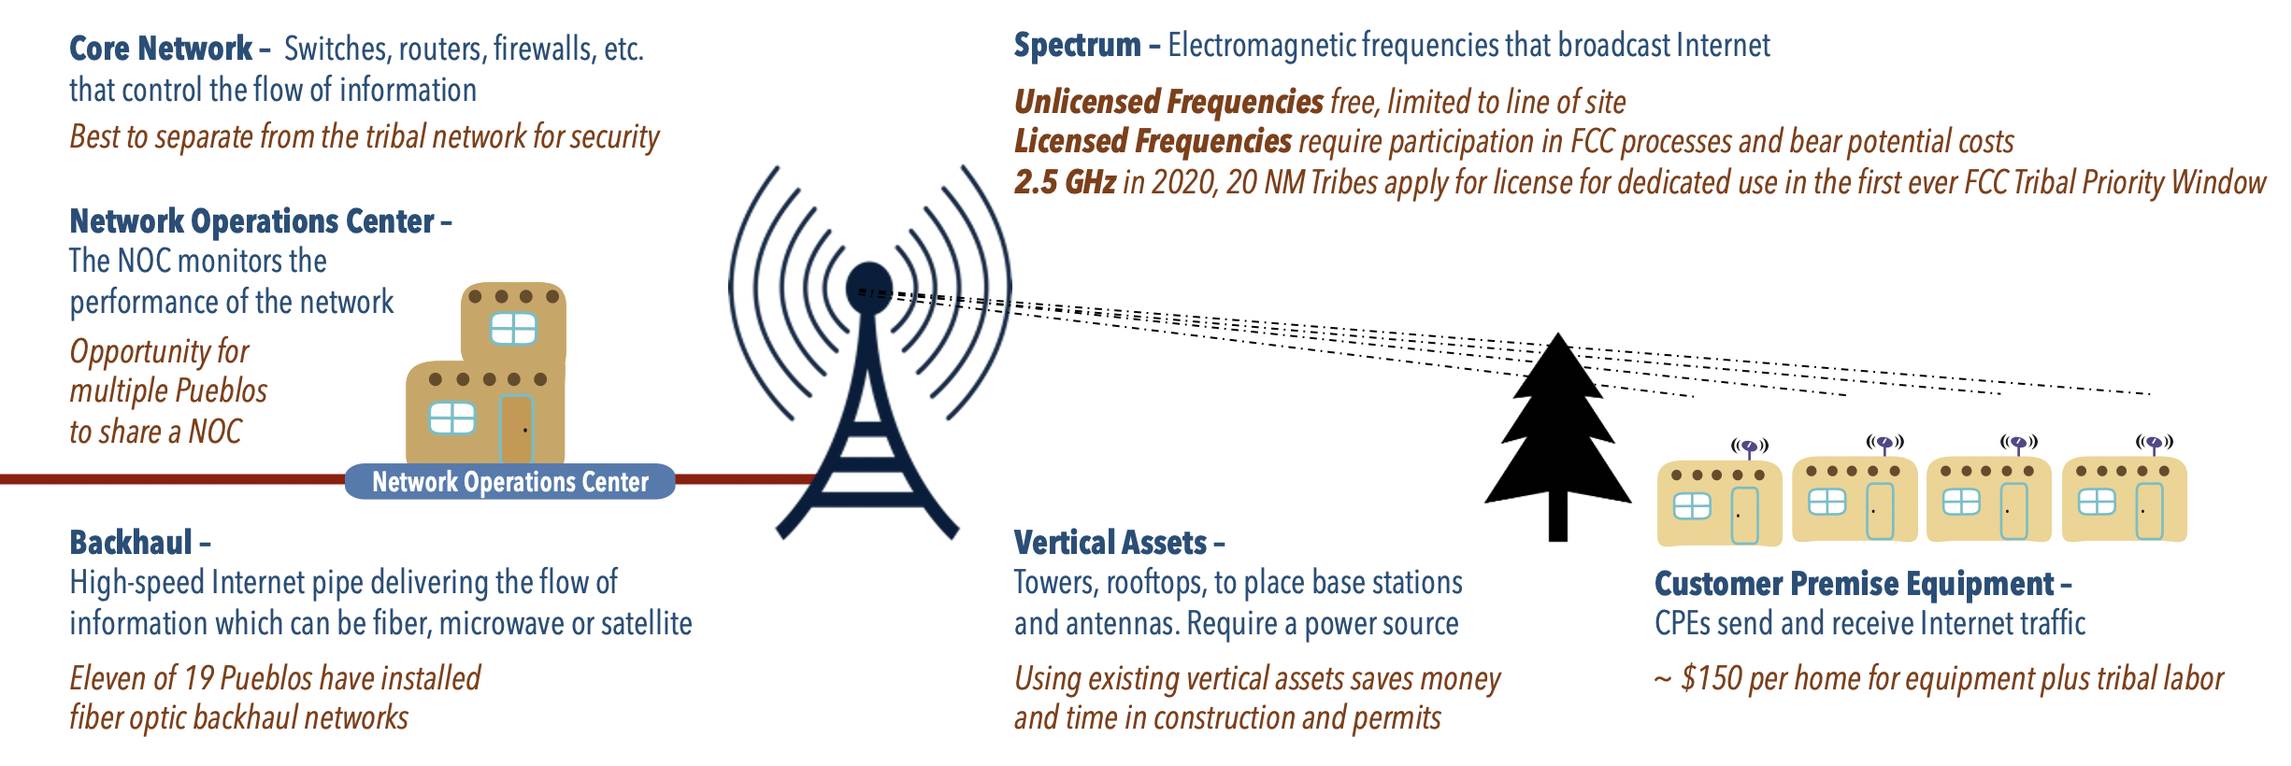

Slide 18
Federal Broadband Programs & support
“We will no longer tolerate stories of working families unable to access work, of students forced to drive miles just to do their homework in a McDonald’s parking lot, of patients cut off from essential health services.”

Slide 19
Priorities
One Hundred Percent Connectivity
Real Affordability
Resilient and Robust Networks
Meaningful Consumer Protections
Historic investments made over the last two years to achieve these goals

Slide 20
American Rescue Plan Act
$350B State & Local Fiscal Recovery Funds
(Final rule published in January)
$10B Capital Projects Fund
- HB2 Appropriated $123M for broadband
- Connect NM Council & DoIT

Slide 21
Infrastructure Investment & Jobs Act
$42.45B Broadband Equity, Access & Deployment (FCC Mapping & Challenge Phases)
$2.75B Digital Equity Act
$2B Expand Tribal Connectivity Fund
$1B Middle Mile Broadband Infrastructure
$2B Additional support (e.g. USDA Reconnect)

Slide 22
Affordable Connectivity Program (FCC)
Must get more people enrolled
http://getinternet.gov/
https://nmstudentconnect.org/for-families/
$14.2 billion FCC benefit program to help ensure that households can afford the broadband they need for work, school, healthcare and more.
$30 per month toward internet service for eligible households and up to $75 per month for households on qualifying Tribal lands. Eligible households can also receive a one-time discount of up to $100 to purchase a laptop, desktop computer, or tablet from participating providers if they contribute more than $10 and less than $50 toward the purchase price.
Lifeline https://www.fcc.gov/general/lifeline-program-low-income-consumers

Slide 23
Supporting broadband
Senator Lujan’s selected legislation:
Plan for Broadband Act
Spectrum Innovation Act
Digital Equity Foundation Act
Uncap America Act
School Bus WIFI
Casework and outreach
Grant search, telcos, federal agencies
Melanie_Goodman@lujan.senate.gov - broadband
Congressionally Directed Spending
Broadband funded through HUD, USDA, …
(past projects: senate.appropriations.gov)

Slide 24
WRAP-UP

