Slide 1
cybersecurity updaTE September 27, 2022
Peter Mantos, state CIO
Raja Sambandam, State CISO

Slide 2
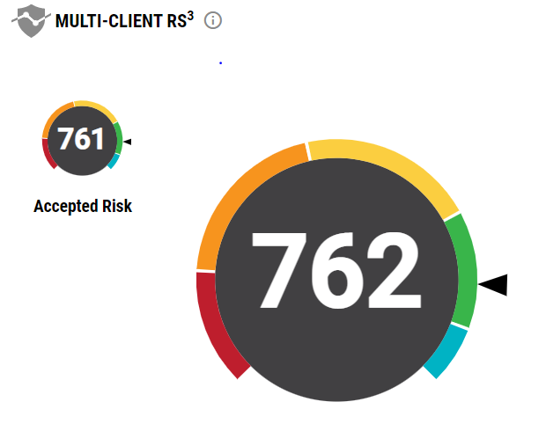
Statewide Cybersecurity updates
70 agencies onboarded to Vulnerability Management Program
Average RS3 Score trending above 760
Ransomware Mitigation Campaign initiated
34 agencies have at least one device exposed to Ransomware
Email campaign initiated to quickly address exposure

Slide 3
Statewide Cybersecurity updates
Statewide Attack Surface Management (ASM) program implemented
Statewide annual Network and Application penetration testing contract signed
Security Operations Center (SOC) gap analysis is ongoing
Security Information and Event Management evaluation in process
Priority 1 – DoIT and DoIT supported agencies
Priority 2 – All other state agencies (need support from agencies to share system log information for monitoring)
Priority 3 &4 – To onboard Schools and local Governments*

Slide 4
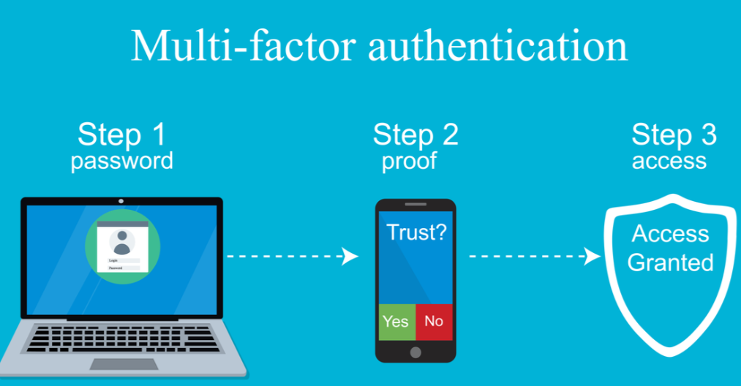
Statewide Cybersecurity updates
Recurring Funding request for $10 million (annually) to sustain existing and inflight Cybersecurity measures
Funding DoIT operations by $8 Million will reduce IT cost by about 12% to all agencies
DoIT act updates for Cybersecurity and Broadband
Collaboration with Broadband for Cybersecurity measure to protect the Broadband infrastructure
Planned migration to NM.GOV (Federal mandate)
Multifactor Authentication for state user community (15k)
Enterprise IT/Security Risk Assessment (annual)

Slide 5
Thank You
Questions?

